Slide 1
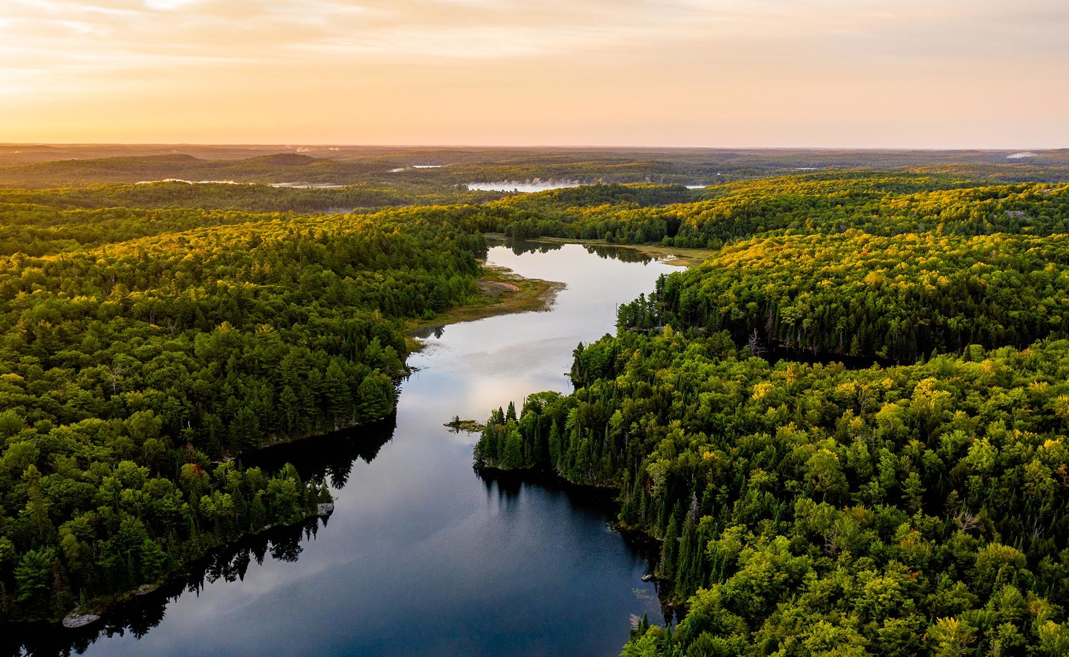
GREEN INDICATOR
FOR G8
COUNTRIES

Slide 2
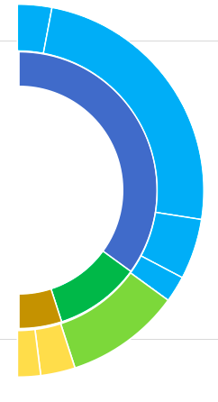
GREEN INDICATOR COMPONENTS
F Gas 15 %
N20 6.5 %
CO2 70 %
Air quality 20 %
Forest 60 %
CH4 8.5 %
Agriculture 40 %
Emissions 70 %
Air quality 20 %
Land 10 %

Slide 3
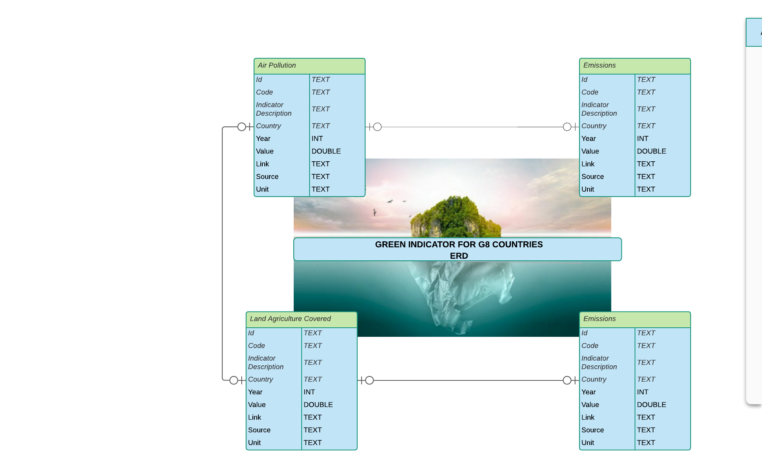

Slide 4

PROCESS AND HIGHLIGHTS
Data Searching
Data Cleaning
Data Analysis
Python
Excel (A lot)
4 Data Sources
World Bank - Python
UN – CSV Download
OECD – CSV Download
CLIMATEWATCHDATA – CSV +API
SQL
7 Normalization
And many calculations for the Final indicator

Slide 5




CHALLENGES

Slide 6
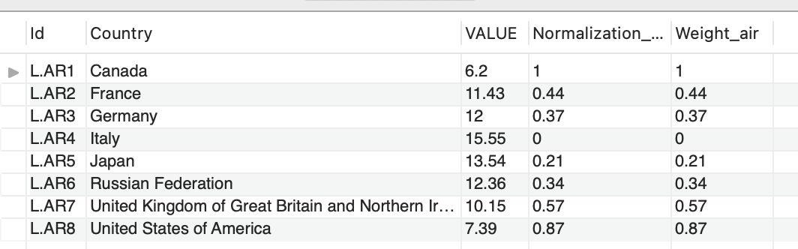
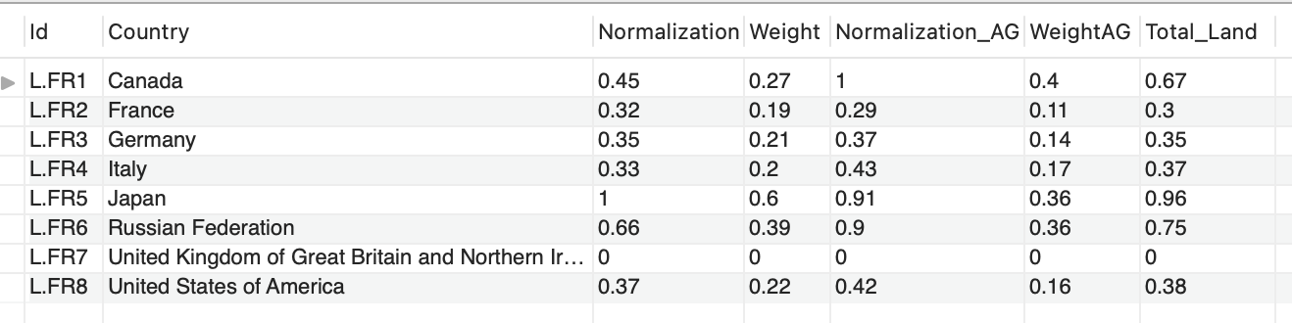
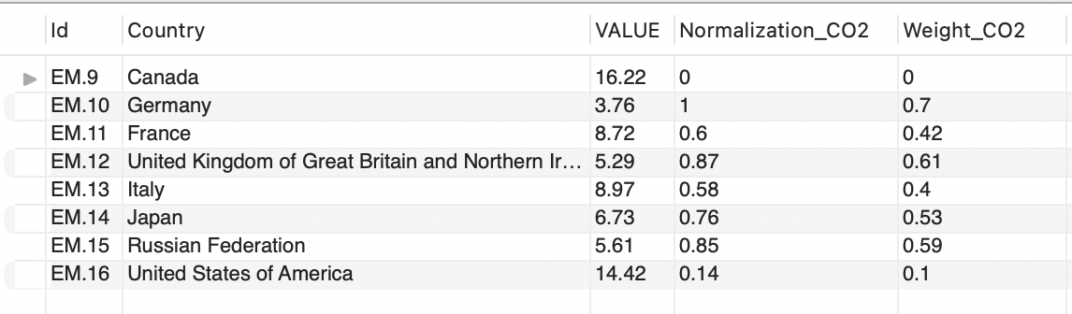
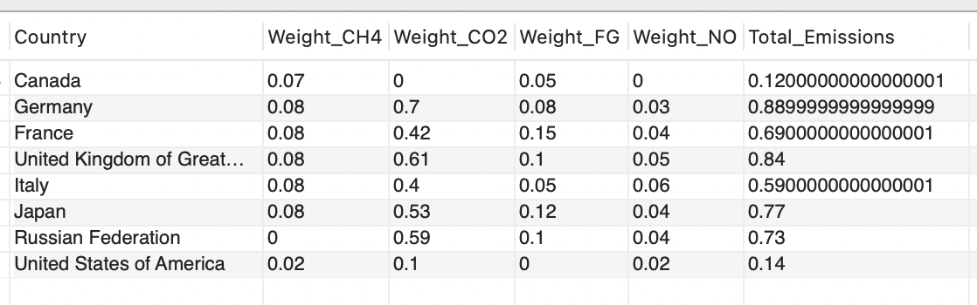
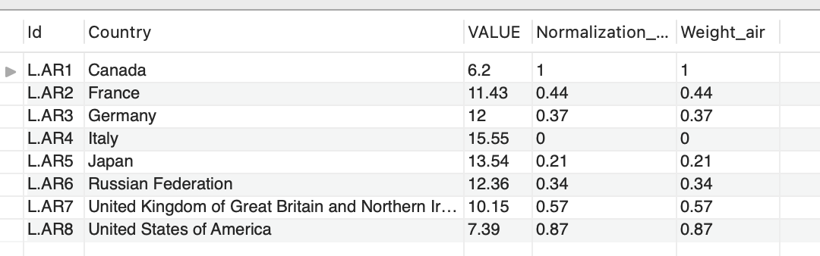
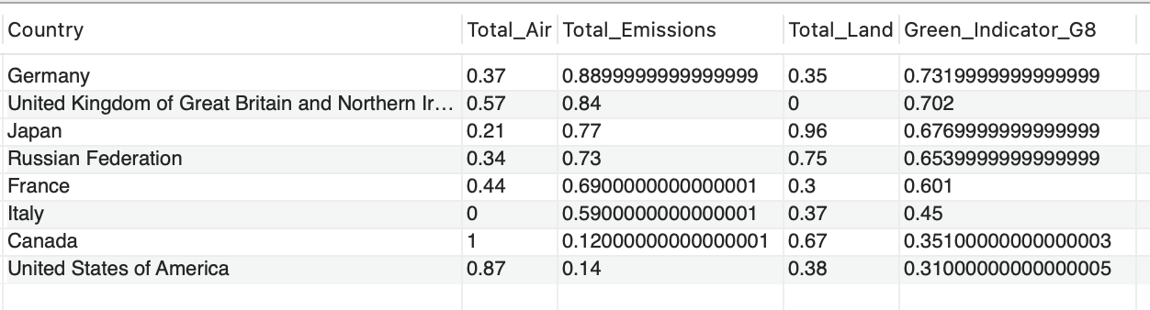
RESULTS

Slide 7

THANK
YOU!

